Slide 1
Sleep Disorders
Treatment

Slide 2

Evolution of Human Sleep Patterns
Very Short Version
As outlined in the Evolution module, the general sleeping pattern of humans contrasts that of other great apes by:
Sleeping on a dedicated ground platform
Having short duration of sleep
Having a high proportion of REM sleep (see Introduction, Neurobiology)
This efficiency in sleep fostered enhanced cognitive abilities, better sleep conditions and time for cultural evolution.
The efficiency in sleep is accompanied by a level of alertness required to avoid predators and other dangers of ancestral life.
Notes:
Image: https://www.chemistryworld.com

Slide 3
Evolution and Sleep Disorders:
Mismatch
Problems with sleep plague modern humans. The ultimate cause of many of these problems may be based on a mismatch between ancestral and modern life. These mismatches include anxiety (hectic life styles!), availability of technology, artificial light, misunderstanding of sleep cycles throughout one’s lifetime, etc.
See Evolution module for details.

Slide 4
Evolution and Sleep Disorders:
Sleep Patterns
It’s also important to keep in mind that sleep patterns vary among cultures and individuals. They also vary throughout the life time of an individual. Different sleeping patterns may not be a disorder, but a reflection of an individual’s biological, life history and cultural situation.
Some sleep disruptions, anomalies and behaviors probably evolved to keep an individual and a family unit safe in the wild world of our ancestors.

Slide 5
Some Common Sleep Problems
Excessive Daytime Sleepiness
Falling asleep at inopportune times during the day is termed Excessive Daytime Sleepiness (EDS). It is a non-specific syndrome usually associated with the sleep disorders that we’ll discuss. In the modern world, it is a side effect of “burning the midnight oil”. People suffering from EDS may also experience depression, obesity, sleep apnea, etc. Treating the primary problem/disorder usually helps. Otherwise, amphetamines may help to prevent daytime sleepiness.
Notes:
See sleepassociation.org for other sleep disorders.

Slide 6
Some Common Sleep Problems
Sleep Apnea
Sleep apnea is defined as irregular pauses and changes in breathing patterns during sleep. These are often accompanied by loud snoring and/or gasping. Sleep is usually fitful. The cause is usually blocked airflow, although rare forms are due to malfunction of brain centers that regulate breathing. Treatments include surgery and devices that help airflow. Many older people suffer from this as air passages change with age.

Slide 7
Acting Out During Sleep
Night Terrors
Some people, most commonly children, display activity during deep or Stage III REM sleep (see Neurobiology module). One is night terrors, an arousal disorder, that is manifested as thrashing and yelling. The eyes may be wide open, but are not seeing. The episodes are usually less than 10 minutes. In the morning, the person has no recollection of the episode. Trying to wake someone up in this condition may lead to injury to the observer or the actor: it’s best to let the incident run its course. Most kids outgrow night terrors.

Slide 8

Acting Out During Sleep
Sleep Walking
Another arousal disorder is sleep walking. Like night terrors, it is more common in children than in adults and is manifested in Stage III NREM sleep. Sleep walking can take many forms: running, walking, getting dressed, moving furniture, etc. Upon waking the person is confused as to how and why they got where they are. The episode should be monitored, but not interrupted. As with night terrors, children tend to grow out of sleep walking.
Notes:
Image: southfloridareporter.com

Slide 9

Sleep Disorders
Body’s Response to Lack of Sleep
A lack of sleep, either chronic or acute, based on disease or self-inflicted, causes real changes in our physiology. Chronic sleep deprivation can lead to diabetes, depression, cardiac problems, obesity, inflammation, and, obviously, fatigue. Some sleep deprivation is due to recognized disorders, some of which will be discussed here. However, insomnia, a relatively common sleep disorder, can be a result of stressors in our modern society.
Getting a crummy night’s sleep leads to many daytime ramifications. The most obvious is daytime sleepiness. Sleep deprivation also results in degradation of mood, performance in school/work, concentration, and interpersonal relationships.
Notes:
Image: clipgound.com

Slide 10
The Sleepless Brain
Long story short: not a good thing. Here are some examples:
The hippocampus: loses ability to consolidate memories
The amygdala/prefrontal connection: interrupted, so emotions aren’t processed. Emotional volatility can result
The brain stem: neurons die
The cerebrum: volume loss in the frontal, temporal and parietal lobes
The temporal lobe: relatively inactive, with impaired language processing
The frontal lobe: decreased activity; judgment is impaired
The prefrontal cortex: impaired ability to make some decisions
Notes:
See Neurobiology module for details
Other information: Why We Sleep, Walker, 2017; brainconnection.brainhq.com

Slide 11

Sleep Disorders
We’ll Discuss
In this module, we’ll discuss two disorders, narcolepsy and restless leg syndrome, that stand apart from what our ancestors may have widely experienced. These two disorders also have some understanding at the genetics and molecular level.
Understanding insomnia from an evolutionary and biochemical viewpoint is the basis for managing some modern sleep disorders (see CBT-I at end of module). Lastly, various societal reasons for disordered sleep will be addressed.
Notes:
Image: toonclips.com

Slide 12

Narcolepsy
Narcolepsy is a difficult disorder with which to live. It occurs in about 0.02% of the population.
Characteristics of this malady are:
Overwhelming sleepiness during the day: these are truly sleep “attacks”.
Paralysis upon waking/falling asleep. Can be accompanied by hallucinations.
Sudden loss of muscle control, cataplexy, usually triggered by emotions. Paradoxically, the person/animal remains awake.
A cataplectic dog
Notes:
See: https://www.ninds.nih.gov/Disorders/Patient-Caregiver-Education/Fact-Sheets/Narcolepsy-Fact-Sheet

Slide 13
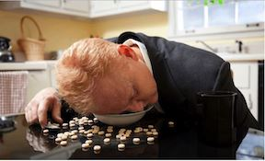
Two Types of Narcolepsy
Type 1:
Patients report overwhelming daytime sleepiness and cataplexy. Assays show low levels of orexins (aka hypocretin), brain hormones associated with wakefulness and arousal (see Neurobiology). Low arousal translates into daytime sleep attacks.
The ultimate cause is loss of cells in the hypothalamus that produce orexins, likely due to autoimmune destruction of these cells.
Type 2:
Patients report overwhelming daytime sleepiness without cataplexy. They also have normal levels of orexins and less severe symptoms and episodes.
The ultimate cause of these episodes of inappropriate daytime sleepiness is difficult to target and treat.
Notes:
https://www.ninds.nih.gov/Disorders/Patient-Caregiver-Education/Fact-Sheets/Narcolepsy-Fact-Sheet

Slide 14
Diagnosis
The primary cause of daytime sleepiness is sleep deprivation, usually due to inadequate time devoted to sleep.
To determine if someone having sleep attacks is truly narcoleptic, tests are run in a sleep lab. In one test, a person takes five short naps, each separated by two hours. The time to fall asleep before each nap is recorded as well as the nature of REM sleep patterns (see Neurobiology).
A person with narcolepsy typically will fall asleep within 8 minutes and have early onset REM sleep with each nap. Normally, there should be a long period of NREM sleep preceding REM sleep
Notes:
https://www.ninds.nih.gov/Disorders/Patient-Caregiver-Education/Fact-Sheets/Narcolepsy-Fact-Sheet

Slide 15
How to Manage Narcolepsy:
Behavior
Behavioral strategies can help manage narcolepsy. These include:
Take scheduled short naps during the day and practice good nighttime sleep hygiene.
Do these things, which tend to help everyone’s sleep: exercise daily, well ahead of going to sleep; avoid caffeine, alcohol and nicotine close to bed time.
Because strong emotions can trigger cataplexy in Type 1 narcolepsy, patients are counseled to avoid emotional triggers, both good and bad. This can make life somewhat boring and restricted.
Notes:
https://www.ninds.nih.gov/Disorders/Patient-Caregiver-Education/Fact-Sheets/Narcolepsy-Fact-Sheet

Slide 16
How to Manage Narcolepsy:
Chemical Assistance
The best drug for treating narcolepsy is Modafinil, a central nervous system stimulant that promotes wakefulness. Through a series of chemical links, it promotes the release of orexins. Obviously, this treatment should be administered early in the day.
Amphetamines, also stimulants, can be helpful, but have lots of side effects and can become addictive.
Antidepressants have been shown to control cataplexy, but also are associated with unwelcome side effects.

Slide 17
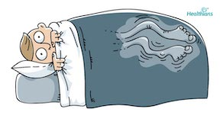
Restless Leg Syndrome
RLS
People with RLS suffer from sleep that is constantly interrupted by unpleasant sensations in the legs accompanied by an irresistible need to move them. Walking helps, but relief is temporary, making it difficult to sustain sleep. Thus, it is generally considered a sleep disorder. Because the disorder is arises from the brain itself, the National Institute of Neurological Disorders and Strokes (NINDS) classified RLS as a neurological sensory disorder.
Notes:
Image: blog.healthians.com
RLS info: https://www.ninds.nih.gov/Disorders/Patient-Caregiver-Education/Fact-Sheets/Restless-Legs-Syndrome-Fact-Sheet

Slide 18
RLS Stats
RLS is not uncommon, affecting 7-10% of people in the U.S. More women than men suffer from RLS. As people age, their symptoms become more troublesome, more frequent and last longer. There is no cure.
Evidence suggests that a dysfunction of the dopamine pathway in the basal ganglia disrupts normal control of movement, leading to involuntary movement and sensations. This dysfunction also is linked to iron deficiency in the brain.
There is a genetic component to RLS found in families where symptoms begin in early adulthood.
Notes:
https://www.ninds.nih.gov/Disorders/Patient-Caregiver-Education/Fact-Sheets/Restless-Legs-Syndrome-Fact-Sheet
Image: blog.healthians.com

Slide 19
Possible RLS Genes
Some types of RLS run in families. Genome-wide association studies have found variants of genes associated with susceptibility to RLS. These genes are: PTPRD, BTBD9, and MEIS1. Generally, they play a role in the development of neurons.
MEIS1 codes for a protein expressed during development, particularly in the vasculature.
PTPRD codes for a protein that has a role in nerve growth
BTBD9 codes for a protein that is thought to interact with products of circadian rhythm genes.
Notes:
Task: Explain how each of these gene products could be linked to RLS.

Slide 20

How to Manage RLS
Behavior
Like most sleep disorders, some behavior modifications may help for those with mild cases. These include the usual prescriptions: moderate exercise, good sleep hygiene, and avoiding alcohol and tobacco. Additionally, leg massages, heating pads, ice packs, and leg-stretching in variable combinations may help those with mild symptoms.
Notes:
https://www.ninds.nih.gov/Disorders/Patient-Caregiver-Education/Fact-Sheets/Restless-Legs-Syndrome-Fact-Sheet
Image: sarcoidosis.com.au

Slide 21
How to Manage RLS
Chemical Assistance
Sufferers with severe cases of RLS usually need chemical assistance, in addition to the remedies noted previously. Iron supplements may help. Serious cases require dopamine agonists to augment low levels of this neurotransmitter found in RLS patients. However, long term use can lead to RLS symptoms becoming unmanageable and more widespread. In such cases, dopamine agonists should be discontinued.
Opioids can be used in severe cases, although there can be serious side effects, including addiction.
Notes:
Image: blog.healthians.com

Slide 22
One Sufferers Story
A young man has been afflicted with RLS for several years. His mom also has RLS, suggesting a genetic component. His case is quite severe. Here is his description of recent experience with the disease:
“….dull ache in legs and arms. Dull ache is punctuated by pulses of pain in my legs (generally femur region). If I don’t medicate, these pulses happen approximately every 10 seconds. Sleep is impossible. This fall my medication ran out and I was unable to sleep for 36 hours straight. It was not fun.” Additionally:
“One challenge with RLS is that you eventually get used to your meds and symptoms can augment (as is my case)”.

Slide 23
What Was His Medication?
He shared with us the medicine he is taking for RLS:
“I currently take two medications for RLS.
(1) Rotigotine 2mg
(2) Gabapentin 900mg
In the past I’ve also taken Ropinirole.”
Rotigotine and Ropinirole are dopamine agonists. Gabapentin is a derivative of the brain neurotransmitter GABA (gamma-amino-butyric acid). It’s used primarily to mediate neuropathic pain as well as to promote sleepiness.

Slide 24
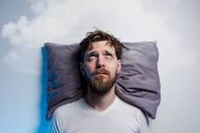
Insomnia
The American Academy of Sleep Medicine defines insomnia as “persistent difficulty with sleep initiation, duration, consolidation or quality.” The Academy unpacks this further by indicating that insomnia has two primary symptoms: 1) sleep difficulties even when there are sufficient opportunities for sleep; and 2) decreased daytime function due to poor sleep quality or duration. Some possible genetic correlates are presented in the Genetics module.
Notes:
Interesting fact: the National Institute of Neurological Disorders and Stroke has nothing on insomnia.
Image: colliersnews.com

Slide 25
Say More….
Insomnia can take many forms. It may be hard to stay asleep or fall asleep in the first place. Maybe the insomniac wakes up too early and can’t get back to sleep. Or a person wakes up after falling asleep and is awake for several hours before falling back asleep again.
Most adults experience acute insomnia, lasting for days or a week or two, at some point in their lives. Chronic insomnia is defined by clinicians as having three nights of bad sleep a week for three months!
It is likely that 10% of the population suffers from chronic insomnia.
Even greater numbers of people will have trouble staying asleep or delay falling asleep at least once a week.
Some people toggle between no insomnia, intermittent (acute) insomnia and chronic insomnia.
No what the aberrant sleep pattern, insomnia is a bummer.
Notes:
More about insomnia in Evolution module

Slide 26
Insomnia Ramifications
Chronic sleep deprivation due to insomnia can lead to diabetes, depression, cardiac problems, obesity, inflammation, and, obviously, fatigue.
Even one night of insomnia leads to many daytime ramifications. The most obvious is daytime sleepiness. Sleep deprivation also results in degradation of mood, performance in school/work, concentration, interpersonal relationships.
Notes:
Image: clipgound.com

Slide 27
Evolution and Insomnia
The ultimate cause of insomnia may be based on a mismatch between ancestral and modern life (see Evolution module for details). These mismatches include anxiety (hectic life styles!), availability of technology, artificial light, misunderstanding of sleep cycles throughout one’s lifetime, etc.
Some sleep disruptions, anomalies and behaviors probably evolved to keep an individual and a family unit safe in the wild world of our ancestors.

Slide 28
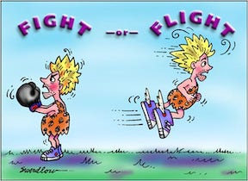
What is the likely physiological basis of insomnia?
Sleep problems, including insomnia, can have, at least partially, environmental causes. These include bright light close to bedtime, caffeine and alcohol, too warm a room, exercise too close to bedtime and inconsistent bedtime.
However, chronic insomnia is thought to be triggered by stress: anxiety and worry.
Responses to stress are mediated by the sympathetic nervous system, jacking up the sufferer into a flight-or-fight response, with several physiological systems in overdrive: body temperature, cardiac function, and release of stress hormones. This is not conducive for sleep!
Notes:
Image: enlightened-consciousness.com

Slide 29

What Else?
During a stress response, parts of the brain that should chill falling sleep and staying asleep do not. These are:
The hippocampus, critical in memory consolidation
The amygdala, the emotional center of the brain
The brain stem, keeping us generally alert.
See Neurobiology for structure details.
Additionally, alertness promoting hormones appear to be elevated as an insomniac attempts sleep. These are cortisol, adrenaline and noradrenaline, which keep both metabolism and cardiac function in a cranked up state.

Slide 30
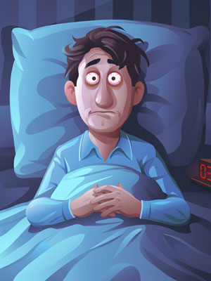
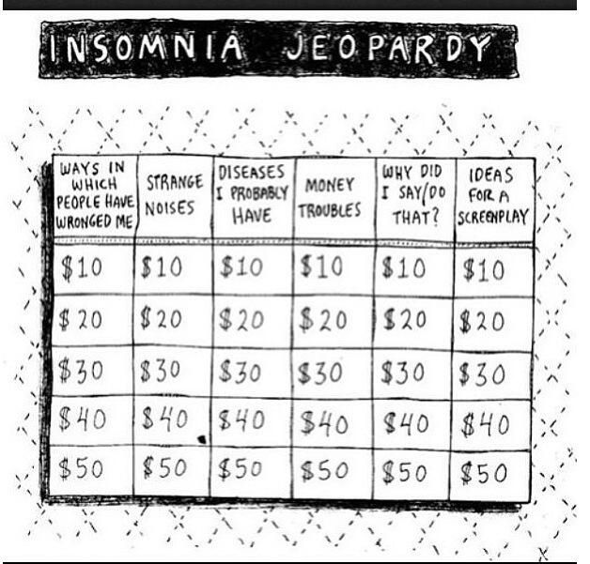
What, Me Worry
At Night?
Roz Chast cartoon
Notes:
Image: morningpicker.com

Slide 31
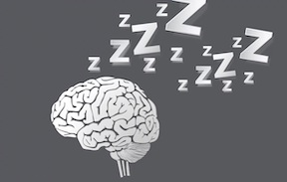
Treatment: Cognitive Behavioral Therapy for Insomniacs
Interrupted sleep for our ancestors probably was based on stress related to very real dangers: monitoring the environment was a good thing (see Evolution module). These dangers are not usually relevant today, but modern stressors lead to sleep problems.
With this in mind, CBT I, Cognitive Behavioral Therapy for Insomniacs, is a non-pharmacological and evidenced way to help insomniacs manage their stress and thus their disorder.
First, the patient is evaluated for possible underlying medical conditions, such as sleep apnea, undergoes a sleep study and keeps a sleep diary.
In a series of meetings, the therapist uses these data to help the patient recognize and manage underlying stressors and how to address them to attain a good night’s sleep.
Notes:
Image: circady.com

Slide 32
CBT-I Techniques
The Sleep Foundation has a full description of the techniques fundamental to CBT-I that are listed here.
Cognitive restructuring: Identify, challenge, alter thoughts/beliefs about insomnia to manage the worry about insomnia. This should include learning about the underlying evolutionary underpinnings of interrupted sleep: a mismatch between ancestral and modern stressor and life history aspects
Stimulus control: Bed is used only for sleep and sex.
Sleep Restriction and Compression: limiting the time in bed to match the time actually asleep, according to a sleep diary. This is increased incrementally over a week or two.
Relaxation training to reduce tension: eg. breathing exercises, muscle relaxation techniques, biofeedback.
Notes:
sleepfoundation.org

Slide 33
Medicating Poor Sleep
Generally, sleep doctors recommend CBT-I as the first course of treatment. This is a sound approach, given what is known about the evolution of human sleep. However, many practitioners and their patients rely on medications that include prescription medicines, over the counter aides and some folk remedies. Most of these prescription medications are used for other maladies as well.
More information can be obtained about the targets of these remedies can be found in the Neurobiology module.
Notes:
Image: colliersnews.com

Slide 34
Over the Counter
Sufferers of poor sleep quality often resort to medications that are readily available at their local pharmacy.
Melatonin is produced by the pineal gland as a signal that it’s time to sleep. Taking this hormone late in the day should contribute to sleepiness.
Antihistamines are used to treat allergies, but they often have the side effect of promoting drowsiness. They are the main ingredient in many OTC sleep aides.
Valerian, an herb in the honeysuckle family, is thought to help insomnia, but the data supporting this claim are inconclusive.

Slide 35

Medications
GABA Receptors
Gamma-aminobutyric acid (GABA) is a neurotransmitter that inhibits wake promoting brain structures. More GABA, more sleep (maybe). These drugs in different ways interact with the receptor for GABA, inhibiting wakefulness.
They generally are recommended for short term use because of possible dependence and other psychological issues.
Drugs in this category are:
Benzodiazepines (eg. Restoril)
Eszopiclone (eg. Lunesta)
Zolpidem (eg Ambien)
Zaleplon (eg. Sonata)
Notes:
Image: disturbmenot.com

Slide 36
Some Other Medications
Some drugs depress wakefulness by modulating other brain neurotransmitters:
Suvorexant (Belsomra) is an orexin receptor antagonist, blocking the effects of the orexin family of neuropeptides.
Doxepin (eg. Silenor) inhibits serotonin reuptake in certain parts of the brain; also an antihistamine
Trazodone inhibits serotonin uptake in certain parts of the brain.
Ramelteon (eg. Rozerem) is a synthetic melatonin analogue that binds to and activates melatonin receptors in SCN.
Notes:
Image: disturbmenot.com

Slide 37

Disparities, Sleep and Tradeoffs
Field Studies
Studying sleep patterns (or lack thereof) in a lab provides a snapshot, usually of patients from wealthy countries. Sleep scientists have begun to study sleep in natural human environments. These field studies collect data on sleep patterns and the tradeoffs between sleep and time required for other activities (see Evolution module). They find that many people in poor countries have challenging sleep environments, including noise, light, bugs, small and shared sleeping spaces and the general stress of earning a living. Poor people living in these countries require more time for work and thus have less time for sleep.
A sleeping vegetable seller in Kolkata, India.
Notes:
See Science 29 Oct 2021 (Vol. 374, pp530 – 533) for review. Image from that article.

Slide 38
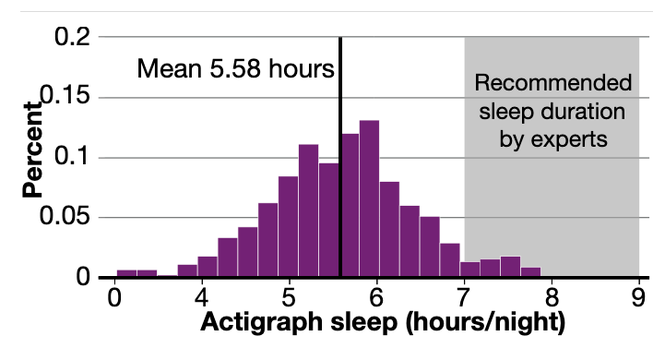
Sleep Patterns
Urban Poor
One study documented the sleep patterns of 452 urban poor people in India. They found that sleep duration was far less than the recommended 7 – 9 hours.
An actigraph is based on a data set collected by a device worn on the wrist to measure the amount and quality of sleep (eg. Fitbit).
Notes:
See Science 29 Oct 2021 (Vol. 374, pp530 – 533) for review. Image from that article.
Data from P. Bessone, G. Rao, F. Schilbach, H. Schofield, M. Toma, Q. J. Econ. 136, 1887 (2021).

Slide 39

Sleep Patterns
Interrupted Sleep
In the same study, the sleep patterns of some individuals were monitored over a 7+ hour period. Sleep quality was poor. This person woke up 31 times; the longest period of sleep was 45 minutes. Fragmented sleep is not good sleep.
Notes:
See Science 29 Oct 2021 (Vol. 374, pp530 – 533) for review. Image from that article.
Data from P. Bessone, G. Rao, F. Schilbach, H. Schofield, M. Toma, Q. J. Econ. 136, 1887 (2021).

Slide 40
Sleep Patterns in These Communities
What to do?
These same researchers designed a study in which participants In were included in one of two interventions: A daily half hour nap; or a bunch of interventions to help augment nighttime sleep. In all measures (well-being, productivity, attention to work, etc.) the naps showed better outcomes than the various interventions, such as financial incentives and better knowledge of sleep.
Suggestions for improving sleep patterns for this cohort include:
More studies on sleep quality in developing countries under environmental conditions.
Provide and study the utility of Cognitive Behavioral Therapy for Insomnia to diverse populations.
Analysis of cost/benefits of daytime naps for individuals and the local economy.
Study a range of environments for real and potential barriers to sleep.
Notes:
Study design and conclusions from P. Bessone, G. Rao, F. Schilbach, H. Schofield, M. Toma, Q. J. Econ. 136, 1887 (2021).

Slide 41
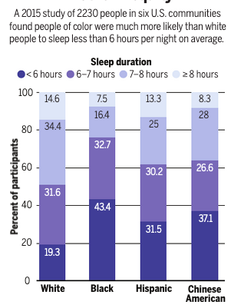
Disparities in Sleep
Racial Inequality
Look closely at this graph. Which group represented gets the most sleep? The least?
Why this inequity? What are some possible remedies?
Notes:
From: Science. Ortega, R. 29 OCTOBER 2021 • VOL 374 ISSUE 6567

Slide 42

The Night Shift
Most researchers think that the observed racial disparity in length and quality of sleep is due primarily to environmental and socioeconomic factors.
One huge socioeconomic factor is night work. Working the night shift is often not conducive to good sleep, especially if the household keeps a daytime schedule. In the U.S., night shifts are disproportionally staffed by Black and Hispanic Americans. People who are not native English speakers may experience additional emotional burdens from work that disrupt sleep.
Notes:
Image: workgearz.com

Slide 43

Environmental Factors
As with poor people in undeveloped countries, urban dwelling minorities in the U.S. tend to live in areas with excessive night time light, which alters the timing of sleep. These areas also tend to be noisier and have higher levels of air pollution, which can cause respiratory problems, making is difficult to sleep well.
People subjected to racial and/or ethnic discrimination, who tend to be persons of color, report higher rates of insomnia than people who tend not to experience such discrimination, who tend to be white.
Notes:
Image: pennlive.com

Slide 44
Some Solutions
Poor sleep is correlated with health issues in minority communities. These include relatively high rates of sleep apnea, hypertension, diabetes, and cardiovascular disease. Unfortunately, many Black and Hispanic people are distrustful of sleep clinics and have neither the time nor resources to utilize them. Thus, researchers are trying to learn about and devise strategies to manage sleep issues in these communities.
Sleep monitoring kits are now available that collect data which can be uploaded to a website. The user gets appropriate health and sleep advice in return.
In addition, a digital version of CBT-I has been developed for people with Spanish as their first language.

Slide 45

Some recommendations for better sleep
Bed room should be conducive for sleep: cool, quiet, good bed and pillows, etc.
No gadgets! Of any kind! Not even your phone!
Try to get some sunlight everyday.
Don’t lie in bed fretting about being awake. Get up, pet the dog and try again.
Go to bed and get up the same time each day.
No naps after 3 pm!
Avoid caffeine, nicotine and alcohol late in the day.
Don’t eat a Thanksgiving-style dinner before going to bed.
Exercise is good, but not close to bed time.
Relax before going to bed: read, knit, take a warm bath, read a boring book, pet the dog.

