Slide 1
Sleep
Introduction

Slide 2

Sleep
Sleep is a focus of our lives and often our conversations:
How did you sleep?
Did you get enough sleep?
Did you have nice dreams/terrible nightmares?
I had trouble falling asleep.
I woke up at 2 am and couldn’t go back to sleep.
I didn’t sleep a wink – I’m exhausted.
I can get by on five hours of sleep a night.
I love to sleep in!
Animals, including humans, are driven to seek sleep. If we don’t get enough, sleep can over take you. This can result in an embarrassing head nod or a loud thump as a book is dropped in the middle of a meeting or class.
Notes:
Image: fashionablymale.net

Slide 3
What is Sleep?
Sleep can be defined broadly as a resting state. In humans, it is characterized by an altered consciousness, especially when we dream. We are mostly unaware of what’s going on in the environment, although we can can be aroused from sleep by an external warning, usual a sound (a crying baby!) or touch. Our bodies, including our brains, change as we experience a night of sleep.
Sleep is characteristic of organisms having a brain, both vertebrates and invertebrates. This fact argues for an evolutionary basis of having a period of time when animals are not actively engaged with their environment (see Evolution). Bodies and brains have time to chill.

Slide 4
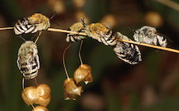
Hypotheses for Why We Sleep
Since sleep is ubiquitous across animal phyla, it surely has important functions. Not mutually exclusive general hypotheses for sleep include:
Making robust and appropriate neuronal connections, including those that are developmentally appropriate (eg. learning, brain maturation);
Forced resting period;
Sharpening the brain for wake time tasks;
Overall maintenance of body - homeostasis.
Sleeping Bees
Notes:
Image: wallpaperflare.com

Slide 5
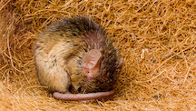
What’s the Cost of Sleep?
What’s the cost?
Sleep can result in periods of lost time, when a critter could be looking for food, feeding, mating, parenting, finding a better place to live, avoiding predators, etc. Inattention also leads to vulnerability to depredation, attacks by parasites, hostile takeovers, etc.
These aspects of sleep are unpacked in the Evolution module.
Any body watching out for the cat?
Notes:
Image: brainfacts.org

Slide 6
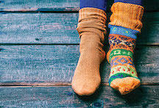
Origins and Functions of Sleep
As stated previously, sleep is intrinsic to having a brain: a shared state across phyla. Thus, to appreciate what goes “wrong”, with human sleep in modern times, an understanding of the evolution of sleep is paramount. It also sheds light on the mismatch between modern cultural pressures and the biological need to sleep (see Evolution).
*There is wide variability in sleeping patterns among cultures and individuals. Sometimes “wrong” is “okay”. More about this in the Evolution module.
Notes:
Image: learningforward.com

Slide 7
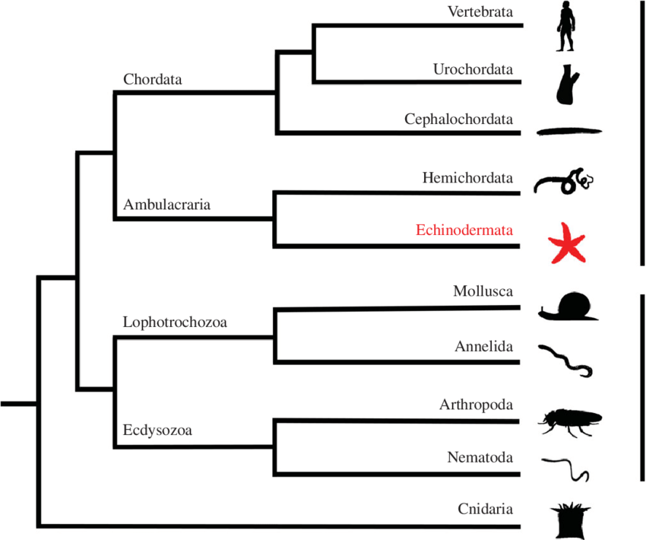
Who Sleeps?
(Or at Least Takes a Serious Rest)
Members of each group shown here show patterns of reduced behavioral and physiological activity during rest/sleep, checking out in some form from the world around them.
Notes:
Image: researchgate.net

Slide 8
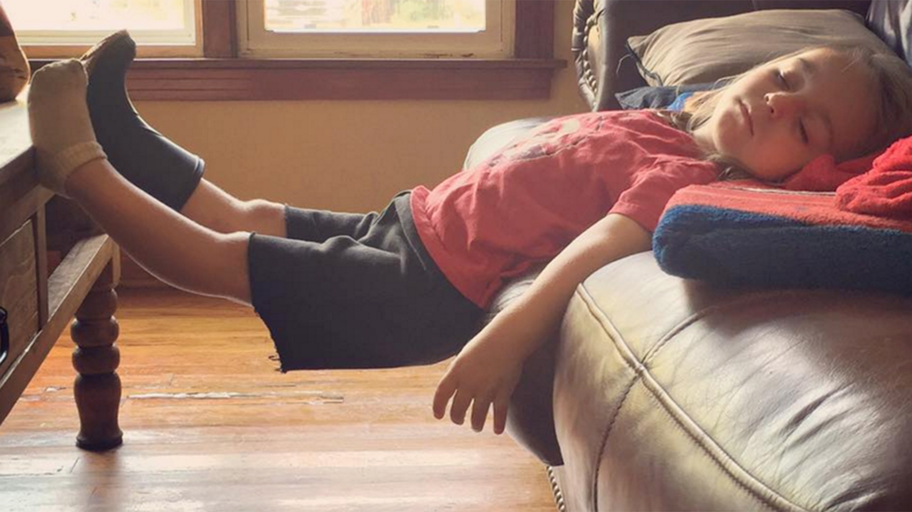
What happens When We Sleep?
The how and why of human, as well as other animals’ sleep, has fascinated scientists for millennia. Older analyses described it as a sort of mini-death, or as a time of diminished brain function and activity. Neither is true, in that sleeping brain is a busy place (see Neurbiology).
When we sleep both our bodies and our brains are working toward restoration, renewal and recovery. Sometimes, we just gotta sleep…..
Notes:
Image: https://media3.s-nbcnews.com/i/newscms/2016_05/957926/places-kids-fall-asleep-today-tease-160202_976559c99c0fd87e9d738d88e79219b1.jpg

Slide 9
Stages of Sleep
Humans
Stages of sleep are defined by the electrical activity of brain neurons (cells) - see Neurobiology for details. Non REM (NREM) sleep is divided into three or four stages.
The first is Stage I, when the brain is switching from wakefulness to sleep.
Stage II is light sleep.
Stage III/IV sleep, also known as slow-wave sleep and deep sleep.
Rapid Eye Movement, REM, sleep is characterized by brain activity similar to being awake and by rapid eye movements under eyelids. Dreaming generally occurs during REM sleep.

Slide 10
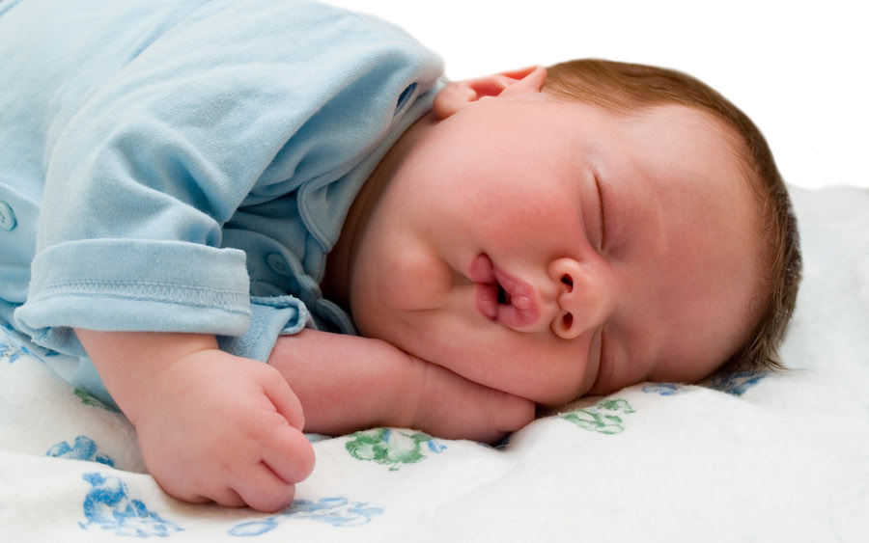
How Much Sleep:
Kids
A human fetus spends most of its time in REM sleep. A new born also spends much of its 18-hour sleep time in REM sleep, but the sleep is intermittent, alternating with periods of wakefulness. As a baby matures, sleep consolidates to one long night of sleep and maybe a nap or two during the day. Sleep researchers agree that REM sleep in young humans is necessary for normal brain development.
Toddlers typically spend 12 hours a day sleeping, with both REM and NREM sleep occurring.
Elementary school kids should sleep 10 to 11 hours each night.
Notes:
http://www.dreamanity.com/wp-content/uploads/2011/10/ws_Sleeping_Baby_2560x1600.jpg
Details in Walker, Why We Sleep

Slide 11

How Much Sleep:
Teens and Adults
Adolescents generally require about 9 hours of sleep each night. Most of the sleeping is devoted to the deep phase of NREM sleep (see Neurbiology of Sleep). This shift in the nature of sleep from REM/NREM to mostly deep NREM sleep is thought to be indicative of a maturing brain. People in their 20’s and 30’s have a balance of REM and deep NREM sleep.
Adults should sleep between 7 – 9 hours each night. However, older adults start to lose some of their deep sleep time and quality; the requirement or 7 to 9 hours of sleep remains the same.
Notes:
http://2hy93b3y7wpb45rh9i135ueo.wpengine.netdna-cdn.com/wp-content/uploads/2016/02/teenager_boy_sleep_tired_studying_books.jpg

Slide 12
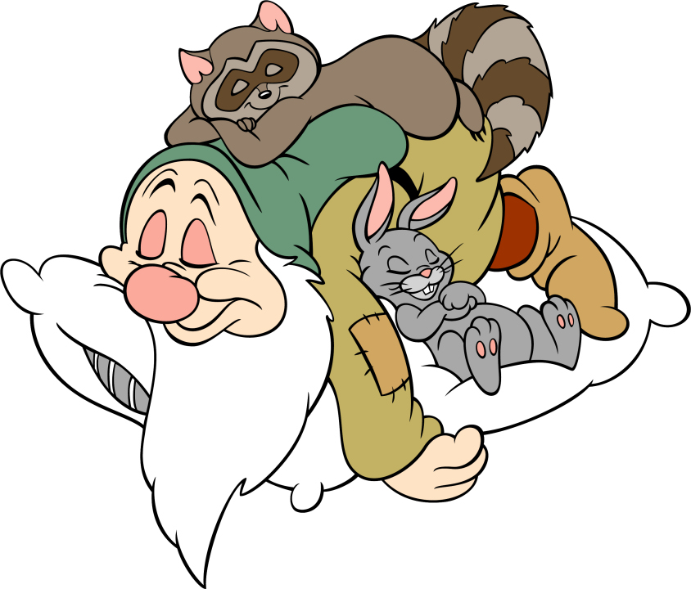
Are We Senseless When We Sleep?
NREM Sleep
Although we are unaware, our central nervous system continues to process information sent from other systems throughout the body during sleep. This includes information from our guts and the cardiovascular system, as well as proprio-receptors that control posture.
NREM sleep is associated with an increase in parasympathetic (PNS) activity and a decrease in sympathetic nervous system (SNS) activity.
Generally, the SNS leads to an uptick in physiological activity – the “fight or flight” response, and the PNS mediates a resting state.
Notes:
Image: http://www.clipartbest.com/cliparts/9i4/ok9/9i4ok96eT.jpeg
See https://www.ncbi.nlm.nih.gov/books/NBK539845/ for a review of the autonomic nervous system.

Slide 13
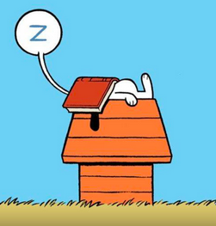
NREM Sleep
Heart and Lungs
Both heart rate and arterial blood pressure go down, with the lowest readings right before deep NREM sleep.
Pressure readings from pulmonary vessels remain constant.
During the early stages of NREM sleep breathing becomes irregular, with hypo-and hyperventilation alternating with regular breathing.
Right before deep sleep (Stage III), breathing becomes regular, but at a slower rate than in light sleep.

Slide 14
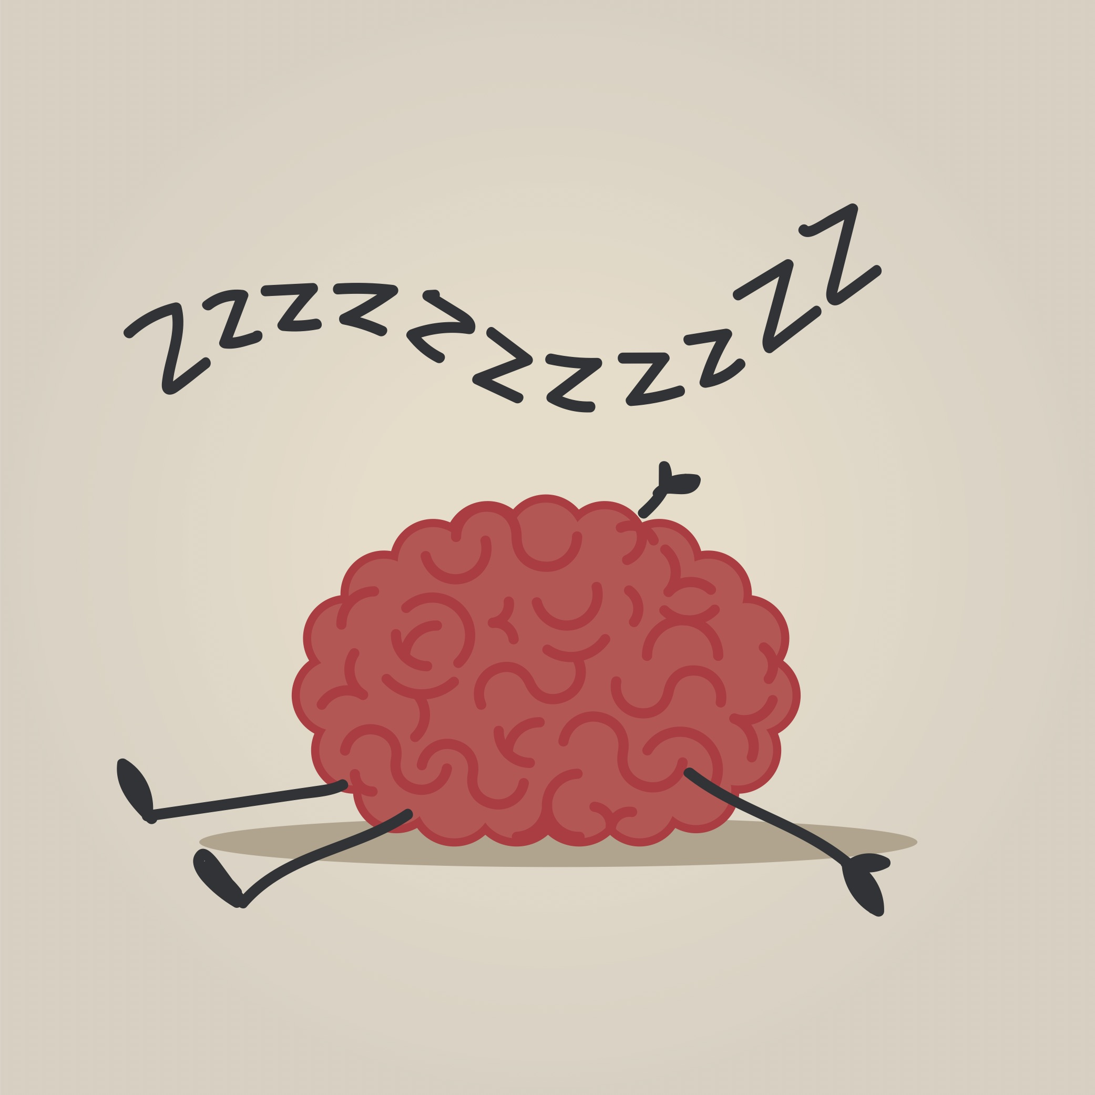
NREM Sleep
Other Stuff
Body temperature goes down.
Hormone production cycles with stages of sleep.
Urine becomes more concentrated, due to increased production of antidiuretic hormone.
The stomach takes a serious rest.
The brain utilizes less glucose than it does when awake. This indicates a general quieting of electrical activity in the brain.

Slide 15
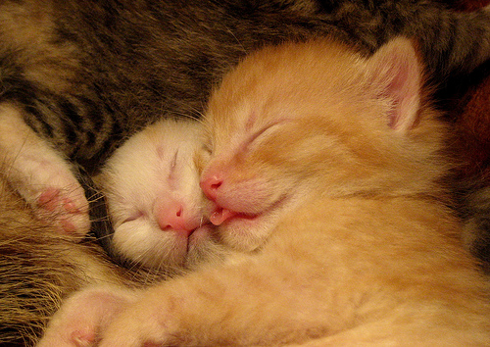
REM Sleep
During REM sleep, central (=brain) control of homeostatic mechanisms is lost.
Brain (specifically, the cortex – see Neurobiology) metabolism goes up compared to being awake.
Respiratory rate is irregular, tending to go up overall. However, periods of apnea and lower rates can occur. This is likely due to changes in muscle activity that accompany REM sleep.
Heart rate and blood pressure become variable. Periods of hypertension are associated with vasoconstriction of skeletal muscles.
Notes:
Image:
https://www.papaleng-amazing-animals.com/2011/12/cats-amazing-sleep-behaviors.html
Cats seem to share sleep patterns and responses with humans, including that of REM sleep.

Slide 16
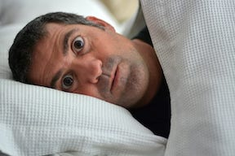
What Happens With Little or No Sleep?
Rats who were chronically deprived of sleep lost their ability to regulate both their body weight (they lost weight) and body temperature (they couldn’t get warm). This research suggests that homeothermy, being a warm-blooded animal, depends on sleep.
Sleep deprivation studies using human subjects show that both NREM and REM sleep are important for physical and mental health.
Notes:
Image: mediblurb.com

Slide 17
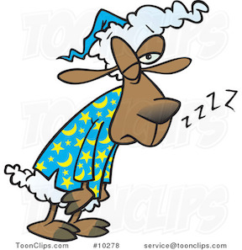
Sleep Deprivation
Matthew Walker provides a list of maladies associated with chronic sleep loss. Those linked to the brain include depression, anxiety, chronic pain, suicide, Alzheimer’s, stroke and more.
Other illnesses linked to sleep deprivation include almost everything that can go wrong physiologically: heart attacks, diabetes, cancer, immune function, etc. His advice (which he states over and over): be sure to get 7-9 hours of sleep each night, or at least during a 24-hour period.
May the sleep be with you.
Notes:
Walker, Why We Sleep, p 133 ff.
Image: toonclips.com

Slide 18
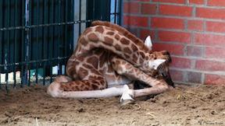
Aspects of Sleep Biology
This portfolio focuses on interwoven aspects of sleep. Together, they present a picture of sleep as a shared characteristic of animals. To understand sleep in this way allows medical professionals to evaluate problems people have with sleep, keeping in mind the broader notion that sleep is fundamental and ubiquitous. However, human sleep patterns do vary among individuals and cultures. Doubtless, sleep problems, primarily sleep interruptions, exist for any animal under stress. It is stressful just to stay alive and have offspring!
A giraffe in a zoo, stressed out due to lack of sleep
Notes:
Image: https://static.dw.com/image/16684272_401.jpg

Slide 19
Sleep Portfolio
Modules
The modules in this portfolio are:
Neurobiology: Includes the brain structures that underlie vertebrate sleep.
Physiology: what happens to the body during sleep.
Genetics: Presents a few genes, primarily those associated with circadian rhythms, known to have variants linked to variation in human sleep patterns.
Sleep and Memory: Discusses a function of sleep that is of high interest to sleep researchers: memory consolidation.
Disorders: Addressed chronic sleep problems with underlying correlates.
Dreaming: Is weird and elusive; of interest to most people.
Evolution: Presents the patterns and commonalities of sleep across phyla and the tradeoffs of sleep with being awake as well as mismatches with modern life.

