Slide 1
Sleep and Memory

Slide 2

Memory Consolidation
Shakespeare, long ago, was on to something regarding what happens when one falls asleep:
But then begins a journey in my head
To work my mind, when body’s work’s expired…
From Sonnet 27
A prevalent theory of why we sleep is to aid memory consolidation. That is, a sleeping brain revisits a day’s experiences and “facts” to sort, sift and make a final version to be solidified as a long term memory. The brain massages and stores information during sleep. It is hypothesized that memory consolidation, learning, enabled Homo sapiens to exploit and utilize its environment.

Slide 3

What is Memory?
Short Term
Short term memory persists for seconds or minutes. It is not retrievable. Have you forgotten a name or address after first hearing it? That is short term memory. Dory, from Finding Nemo, was famous for forgetting information within minutes of obtaining it. She was unable to transfer that info to long term memory.
Notes:
Image: https://www.grandforksherald.com/incoming/article1143276.ece/alternates/BASE_LANDSCAPE/Dory

Slide 4
What is Memory?
Long Term
Long term memories are those that are organized and stored more or less permanently. They become consolidated. How permanent these are depends on their importance and how much they are practiced or relived.
They can be classified as:
Semantic: “book learning” “facts” – knowledge gained through the senses
Episodic: the movie of your life (not terribly reliable)
Implicit: “muscle memory” – how to ride a bike, jump rope, drive a tractor, swing a bat

Slide 5
Memory
Key Brain Structures
Long term memories are defined by sensory information being encoded, stored and retrievable.
Encoding is converting sensory input to a form that can be stored in the brain.
The hippocampus, in the temporal lobe, “decides” which inputs from the thalamus should be “forwarded” on to other parts of the brain.
The prefrontal cortex serves as a store for short term and working memory. It is the next “stop” after information leaves the hippocampus.
Although other brain structures are involved, of special importance are the amygdala, paired structures in the temporal lobe, important for processing information that has an emotional context.
Notes:
The neocortex also processes information, serving to enhance learning and reasoning.

Slide 6
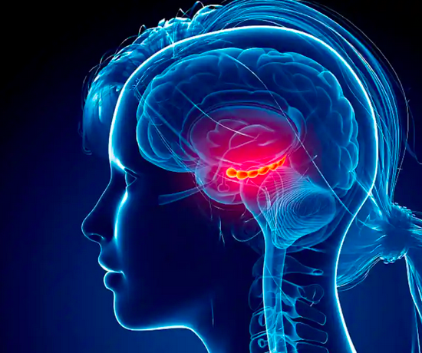
Short Term Memory
The hippocampus
Sensory information passes through the thalamus. Processing this information to form memories begins in a region of the brain known as the hippocampus. If injury results in its loss, the sufferer can’t learn anything new, but long-term memories persist. The prefrontal cortex plays a role in this analysis. Long term memories are stored in regions of the cerebral cortex.
The hippocampus is shown as “lit up”. It resides in the medial temporal lobe.
Notes:
Image: human-memory.net

Slide 7
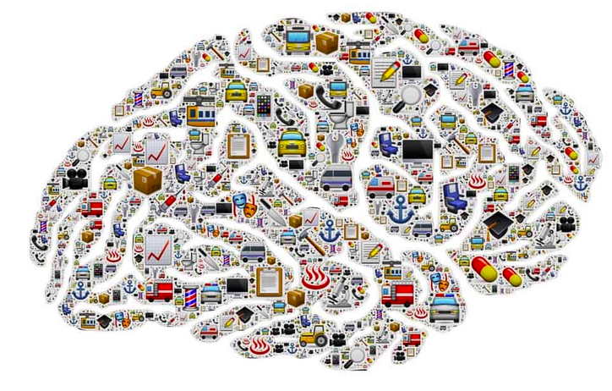
Memory Storage
Sensory aspects (auditory, visual, tactile, etc.) of a long term memory are stored in various parts of the cerebral cortex. These memories can be modified by new input processing and consolidation: aka synaptic plasticity.
Notes:
Image: human-memory.net

Slide 8
Memories
Synaptic Plasticity
For sensory inputs (information) to be stored as memories, they are encoded in ways that change neuronal (cellular) structures and relationships. This is accomplished by a combination of :
Activation of gene expression, leading to new protein synthesis
Modification of existing proteins
Modification or creation of new synapses
This synaptic plasticity is optimized during sleep when levels of the neurotransmitter acetylcholine,
associated with wakefulness, are low.
Notes:
Do we want to include info about how these modifications occur?

Slide 9
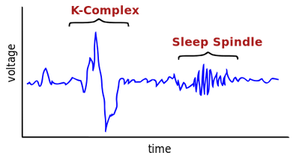
Sleep
Preparing the Brain to Store Memories
It’s likely that a good night’s sleep prepares the brain for learning the next day. This is accomplished by the transfer of a day’s impressions and facts stored short term in the hippocampus to eventual long term storage in the cerebral cortex. The hippocampus is “cleared” for new information. Sleep studies show that this transfer is correlated with Sleep Spindles and K Complexes brain activity, that occur in NREM Stage 2 sleep (see Neurobiology).
Notes:
Image: common. This one from Wikipedia

Slide 10

Sleep
Consolidating Information
Staying up all night studying for a test rarely works for real learning. The best one can do is cough up the information soon after, knowing that it will be elusive. Moreover, a sleep deprived brain can’t really pay attention to new information.
An interval of sleep allows information to become retrievable by moving it to more-or-less permanent storage in the cerebral cortex, forming a long-term memory.
Notes:
Image: world.edu

Slide 11
How Does This Happen?
Deep Sleep
Studies where sleep researchers woke up subjects outfitted with electrodes to monitor brain activity (the subjects did agree to be in the studies!) at various intervals after learning some facts showed that memory consolidation was associated with sleep that happens early in the sleep period. This is when Stage III NREM sleep, also called deep sleep, also called slow wave sleep, was more prominent than REM sleep. These, and MRI studies, confirmed that information was transferred from the hippocampus, where memory is stored short-term to the cortex during Stage III NREM sleep. These together are the physical spaces for memory consolidation.

Slide 12
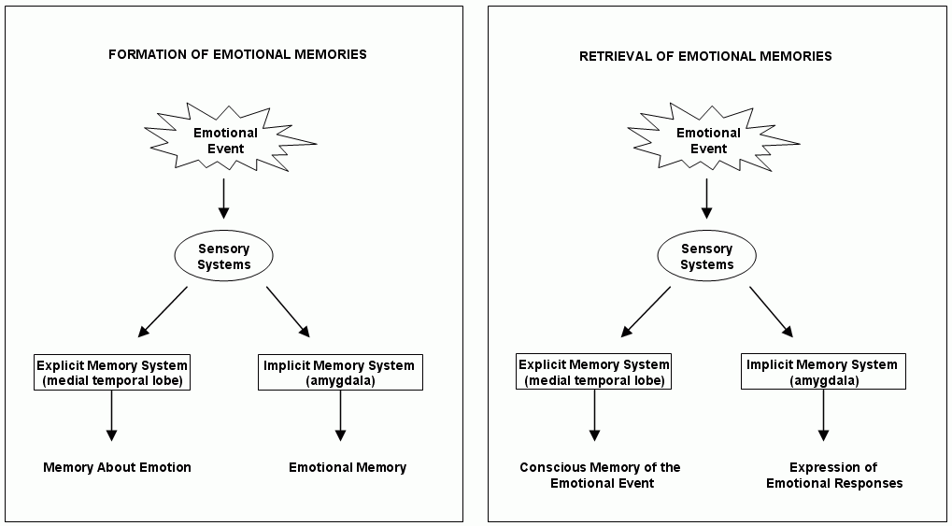
Emotional Memories
Events with which we attach an emotional context rely on sensory input to the thalamus and on to the hippocampus, those structures that lie in the temporal lobe of the brain, and on to the pre-frontal cortex. This knowledge then comes to reside in various parts of the cortex. Thus, we recognize that the memory has an emotional context. The same inputs to the amygdala are encoded as the emotion itself.
Notes:
Image: http://scholarpedia.org/article/Emotional_memory

Slide 13
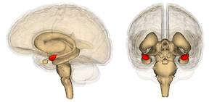
Emotions and Sleep
The amygdala moderates emotions, including anger and the “fight or flight” response in vertebrates. MRI brain scans show that the amygdala of sleep deprived young adults, when shown pictures that elicit strong negative emotions, were way more reactive than those of individuals that got a full night’s sleep. Sleep deprived individuals were also more irritable than the control subjects.
The amygdala are shown in red
Notes:
Walker, p. 147.
Image: psypost.org

Slide 14
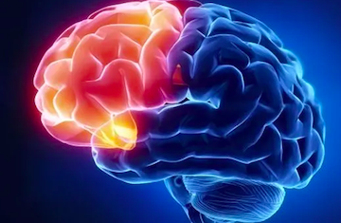
Emotional Memories:
Amygdala and Prefrontal Cortex
Key to understanding over-reactive amygdala is the pre-frontal cortex. It acts as a “brake” to the amygdala “gas pedal” to emotional overreaction. This connection deteriorates with loss of sleep.
Prefrontal cortex
Notes:
Image: neurosciencenews.com

