Slide 1
Sleep, Beautiful Sleep
Overview of
Sleep and Your Body

Slide 2

Sleep
Sleep is a focus of our lives and often our conversations:
How did you sleep?
Did you get enough sleep?
Did you have nice dreams/terrible nightmares?
I had trouble falling asleep.
I woke up at 2 am and couldn’t go back to sleep.
I didn’t sleep a wink – I’m exhausted.
I can get by on five hours of sleep a night.
I love to sleep in!
Animals are driven to seek sleep. If we humans don’t get enough, sleep can over take you. This can result in an embarrassing head nod or a loud thump as a book is dropped in the middle of a meeting or class.
Notes:
Image: fashionablymale.net

Slide 3
What is Sleep?
Sleep in humans is characterized by an altered consciousness, especially when we dream. We are mostly unaware of what’s going on in the environment, although we can can be aroused from sleep by an external warning, usual a sound (a crying baby!) or touch. Our bodies, including our brains, change as we experience a night of sleep.
Sleep is characteristic of both vertebrates and invertebrates. This fact argues for an evolutionary basis of having a period of time when animals are not actively engaged with their environment (see Evolution; Circadian Rhythms). They are giving their bodies and brains time to chill.

Slide 4
Hypotheses for Why We Sleep
Since sleep is ubiquitous across animal phyla, it surely has important functions. Not mutually exclusive general hypotheses include:
Making robust and appropriate neuronal connections, including those that are developmentally appropriate (eg. learning, brain maturation);
Forced resting period;
Sharpening the brain for wake time tasks;
Overall maintenance of homeostasis.
What’s the cost?
Long periods of inattention when a critter could be feeding, mating, finding a better place to live, avoiding predators, etc.
These aspects of sleep are unpacked in the Evolution module.

Slide 5

What happens When We Sleep?
The how and why of human, and other animals’ sleep, has fascinated scientists for millennia. Older analyses described it as a sort of mini-death, or as a time of diminished brain function and activity. Neither is true, in that sleeping brain is a busy place (see Neurology).
When we sleep both our bodies and our brains are working toward restoration, renewal and recovery. Sometimes, we just gotta sleep…..
Notes:
Image: https://media3.s-nbcnews.com/i/newscms/2016_05/957926/places-kids-fall-asleep-today-tease-160202_976559c99c0fd87e9d738d88e79219b1.jpg

Slide 6
Stages of Sleep
Humans
Stages of sleep are defined by the electrical activity of brain neurons (cells) - see Neurology for details. Non REM (Rapid Eye Movement) sleep is divided into three or four stages.
The first is Stage I, when the brain is switching from wakefulness to sleep.
Stage II is light sleep.
Stage III/IV sleep, also known as slow-wave sleep and deep sleep.
Rapid Eye Movement, REM, sleep is characterized by brain activity similar to being awake and by rapid eye movements under eyelids. Dreaming generally occurs during REM sleep

Slide 7
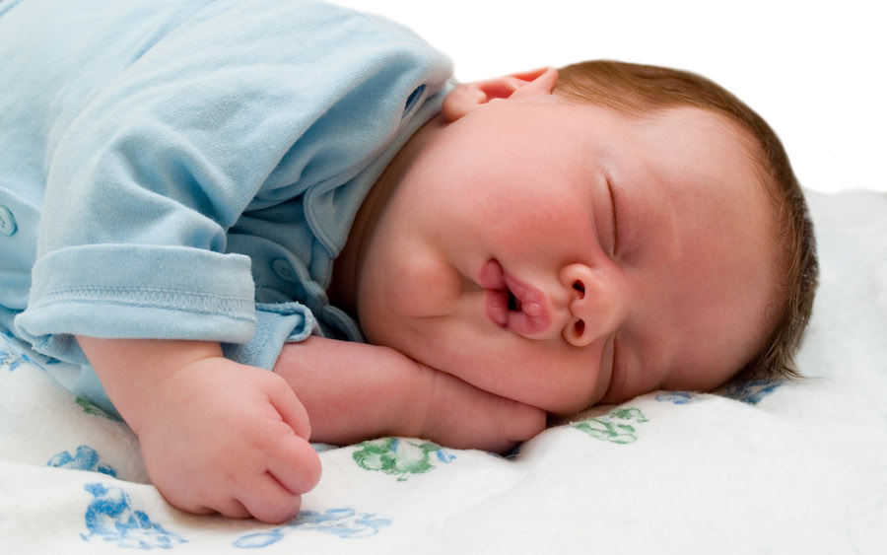
How Much Sleep:
Kids
A human fetus spends most of its time in REM sleep. A new born also spends much of its 18-hour sleep time in REM sleep, but the sleep is intermittent, alternating with periods of wakefulness. As a baby matures, sleep consolidates to one long night of sleep and maybe a nap or two during the day. Sleep researchers agree that REM sleep in young humans is necessary for global brain development.
Toddlers typically spend 12 hours a day sleeping, with both REM and NREM sleep occurring.
Elementary school kids should sleep 10 to 11 hours each night.
Notes:
http://www.dreamanity.com/wp-content/uploads/2011/10/ws_Sleeping_Baby_2560x1600.jpg
Details in Walker, Why We Sleep

Slide 8

How Much Sleep:
Teens and Adults
Adolescents generally require about 9 hours of sleep each night. Most of the sleeping is devoted to the deep phase of NREM sleep (see Neurology of Sleep). This shift in the nature of sleep from REM/NREM to mostly deep NREM sleep is thought to be indicative of a maturing brain. People in their 20’s and 30’s have a balance of REM and deep NREM sleep.
Adults should sleep between 7 – 9 hours each night. However, older adults start to lose some of their deep sleep time and quality; the requirement or 7 to 9 hours of sleep remains the same.
Notes:
http://2hy93b3y7wpb45rh9i135ueo.wpengine.netdna-cdn.com/wp-content/uploads/2016/02/teenager_boy_sleep_tired_studying_books.jpg

Slide 9
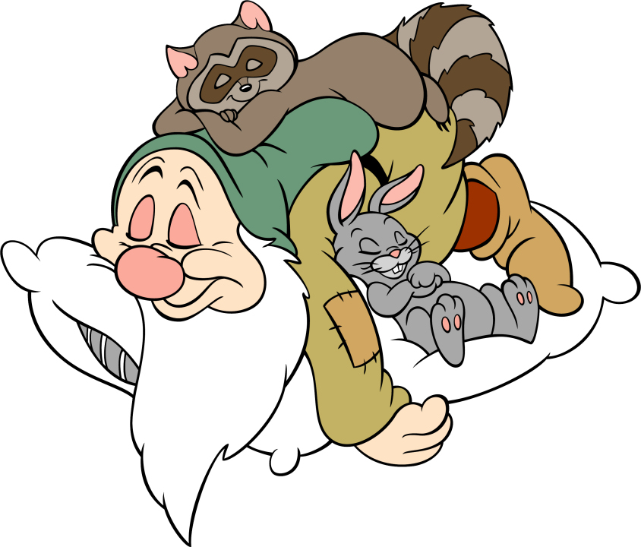
Are We Senseless When We Sleep?
NREM Sleep
Although we are unaware, our central nervous system continues to process information sent from other systems throughout the body during sleep. This includes information from our guts and the cardiovascular system, as well as proprio-receptors that control posture.
NREM sleep is associated with an increase in parasympathetic (PNS) activity and a decrease in sympathetic nervous system (SNS) activity.
Generally, the SNS leads to an uptick in physiological activity – the “fight or flight” response, and the PNS mediates a resting state.
Notes:
Image: http://www.clipartbest.com/cliparts/9i4/ok9/9i4ok96eT.jpeg
See https://www.ncbi.nlm.nih.gov/books/NBK539845/ for a review of the autonomic nervous system.

Slide 10
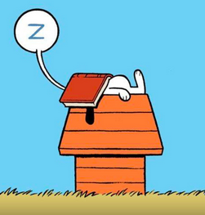
NREM Sleep
Heart and Lungs
Both heart rate and arterial blood pressure go down, with the lowest readings right before deep NREM sleep.
Pressure readings from pulmonary vessels remain constant.
During the early stages of NREM sleep breathing becomes irregular, with hypo-and hyperventilation alternating with regular breathing.
Right before deep sleep (Stage III), breathing becomes regular, but at a slower rate than in light sleep.

Slide 11
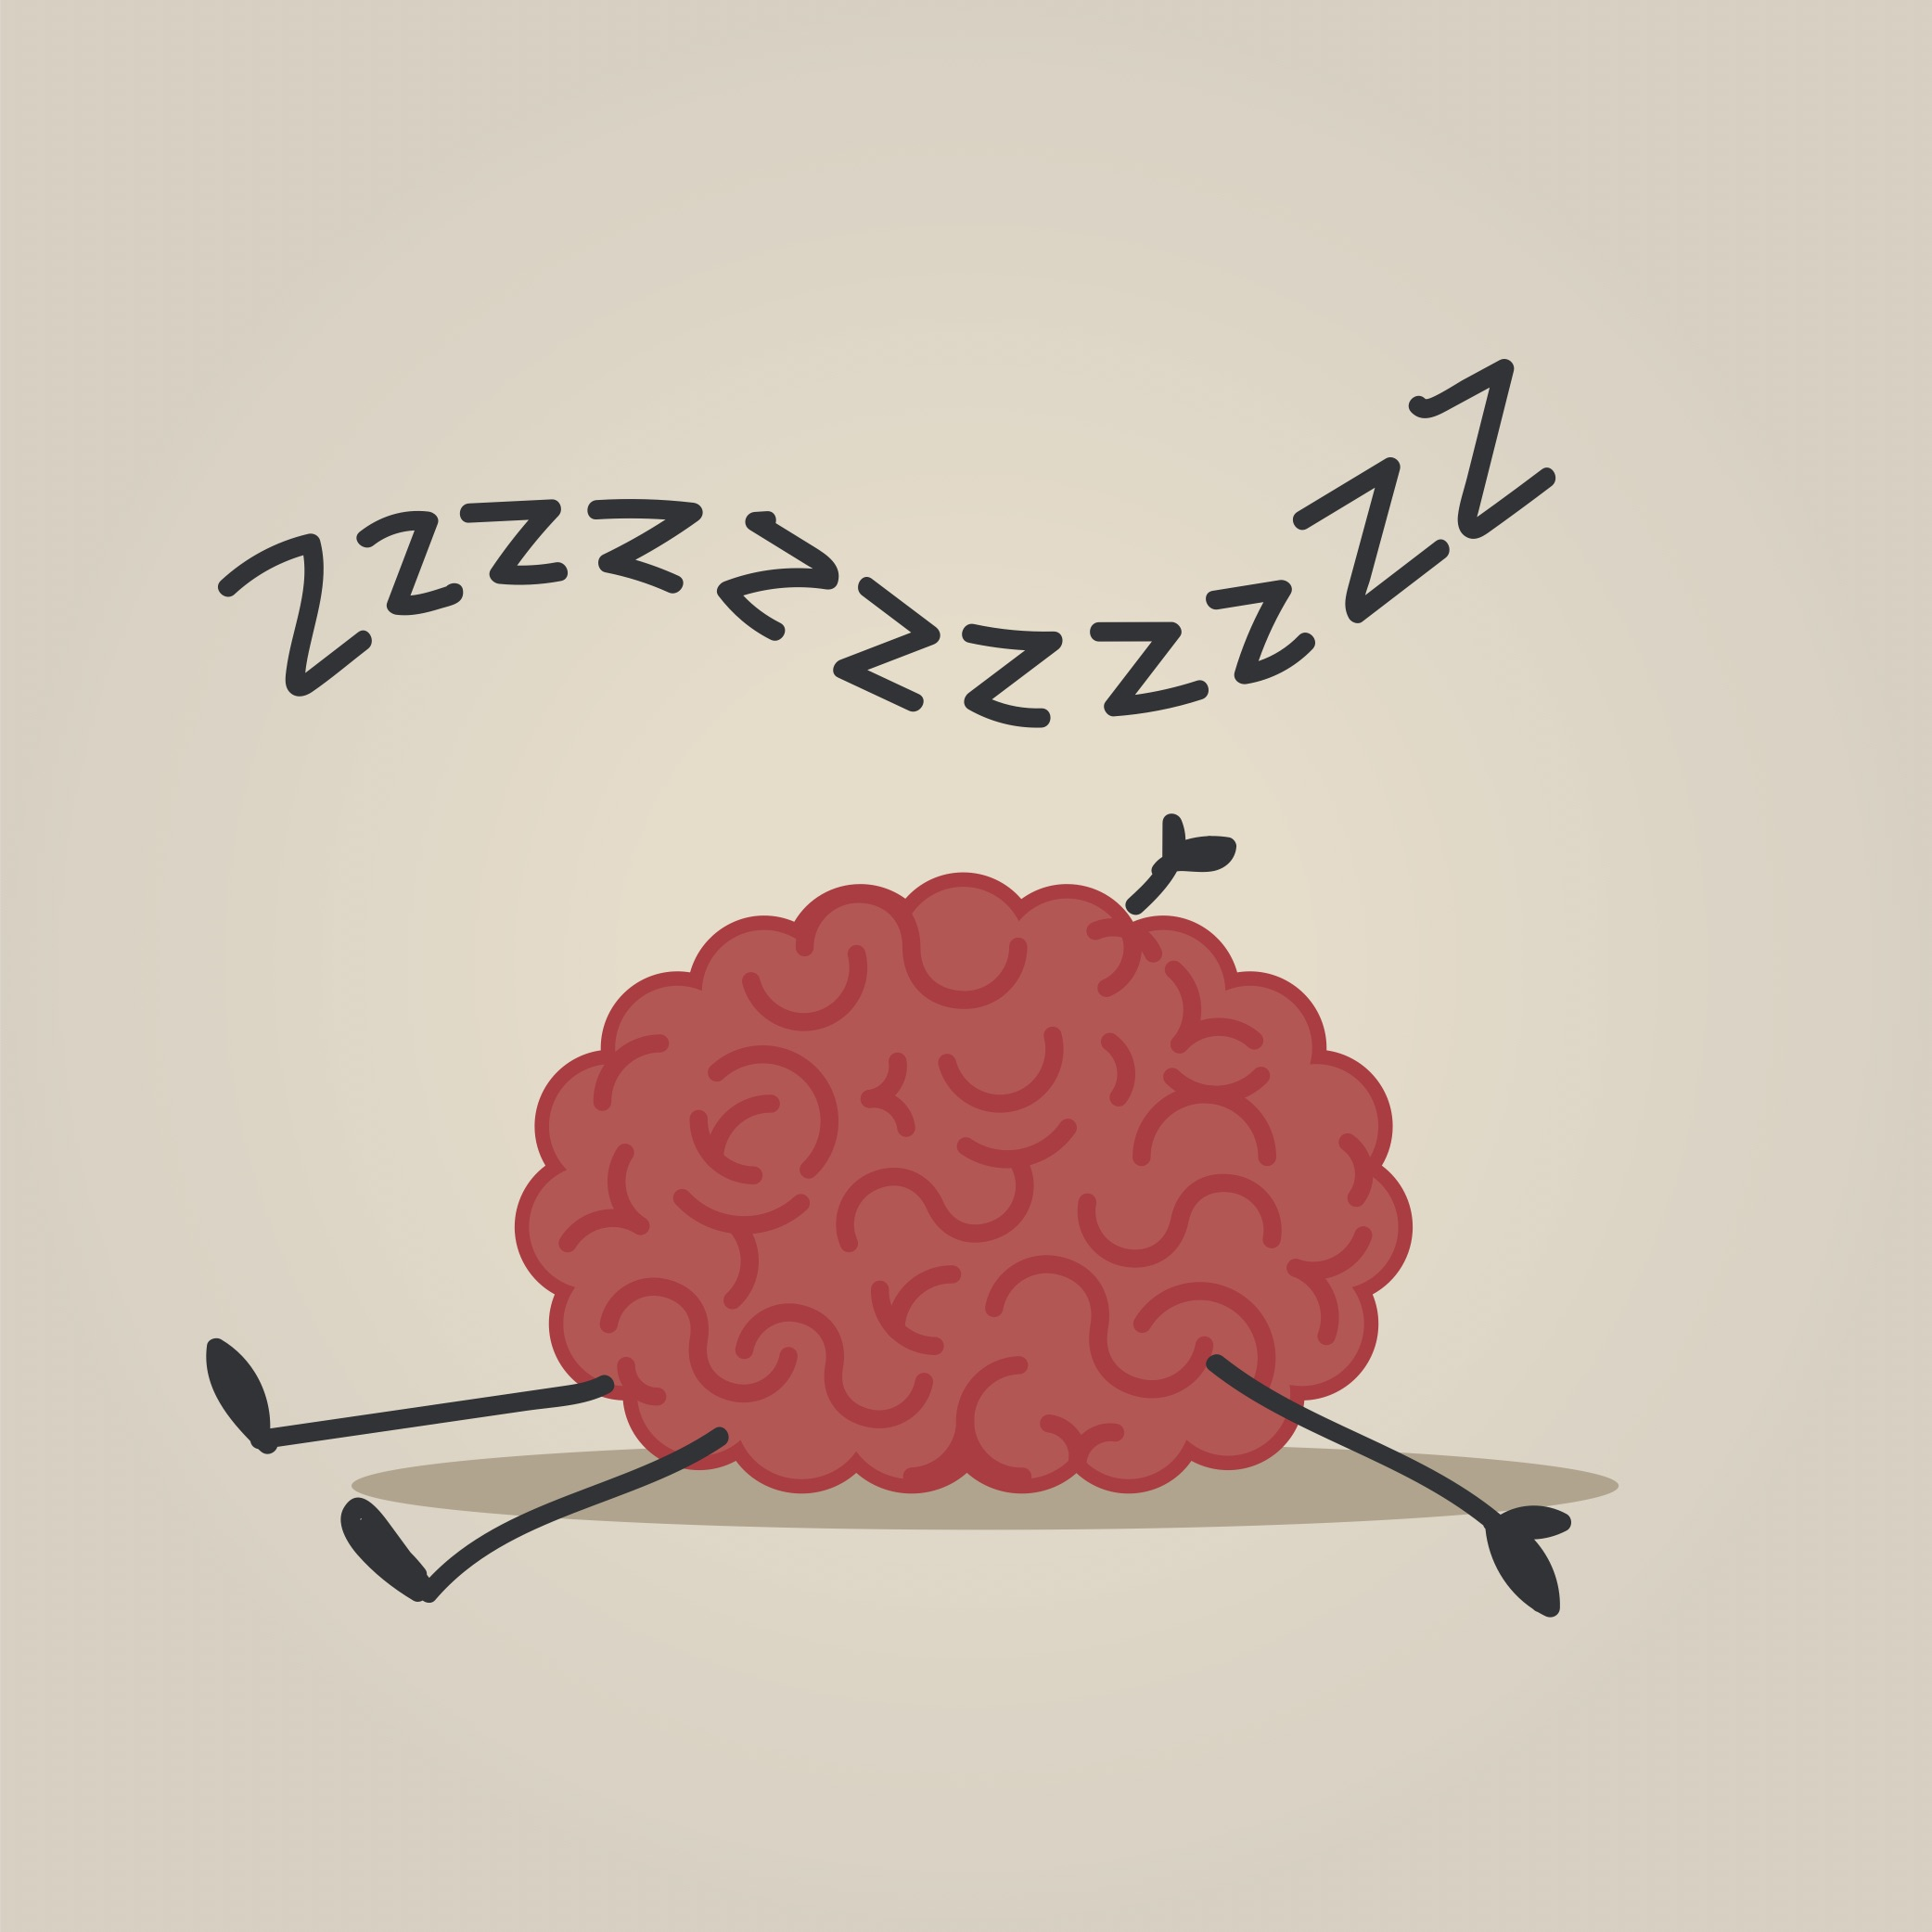
NREM Sleep
Other Stuff
Body temperature goes down.
Hormone production cycles with stages of sleep.
Urine becomes more concentrated, due to increased production of antidiuretic hormone.
The stomach takes a serious rest.
The brain utilizes less glucose than it does when awake. This indicates a general quieting of electrical activity in the brain.
Notes:
Image: http://www.lanternaeducation.com/wp-content/uploads/2018/03/brain-sleeping.jpg

Slide 12
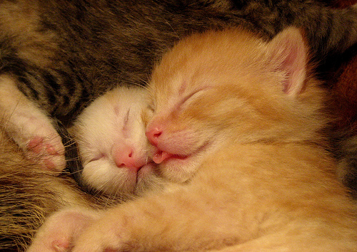
REM Sleep
During REM sleep, central (=brain) control of homeostatic mechanisms is lost.
Brain (specifically, the cortex) glucose metabolism goes up compared to being awake.
Respiratory rate is irregular, tending to go up overall. However, periods of apnea and lower rates can occur. This is likely due to changes in muscle activity that accompany REM sleep.
Heart rate and blood pressure become variable. Periods of hypertension are associated with vasoconstriction of skeletal muscles.
Notes:
Image:
https://www.papaleng-amazing-animals.com/2011/12/cats-amazing-sleep-behaviors.html
Cats seem to share sleep patterns and responses with humans, including that of REM sleep.

Slide 13
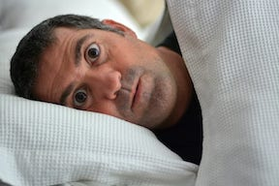
What Happens With Little or No Sleep?
Rats who were chronically deprived of sleep lost their ability to regulate both their body weight (they lost weight) and body temperature (they couldn’t get warm). This research suggests that homeothermy, being a warm-blooded animal, depends on sleep.
Sleep deprivation studies using human subjects show that both NREM and REM sleep are important for physical and mental health.
Notes:
Image: mediblurb.com

Slide 14

Sleep Deprivation
Matthew Walker provides a list of maladies associated with chronic sleep loss. Those linked to the brain include depression, anxiety, chronic pain, suicide, Alzheimer’s, stroke and more.
Other illnesses linked to sleep deprivation include almost everything that can go wrong physiologically: heart attacks, diabetes, cancer, immune function, etc. His advice (which he states over and over): be sure to get 7-9 hours of sleep each night, or at least during a 24-hour period.
May the sleep be with you.
Notes:
Walker, Why We Sleep, p 133 ff.
Image: toonclips.com

